Slide 1
How to communicate effectively in computer programming
By Will Shealer

Slide 2
Just talk to your team
Before going to any of these solutions just lean to your right or left and talk to your team and plan what your next move is.
Talking to your team is a lot my simple and probably will reduce headaches because some of these things just straight up break sometimes.

Slide 3
Be professional
When talking to your team be professional. You need to get the work done get it done.
Don’t talk about memes talk about your strategy and how to get the work done as fast as you can.

Slide 4

Github
GitHub is by far the best way to send files around its very easy and simple it reduces many headaches in the team.
Github

Slide 5
How to use github
Github is used by people making repositories and other people can fork it and can take that code and work on it.
When people are done working on the code they can create a pull request and have it accepted by the owner of the repository and there code is now in that repository that allows people able to share files very easily.

Slide 6
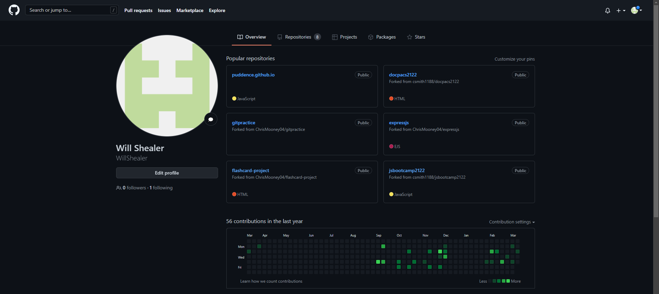
Github looks like

Slide 7
discord
Discord is used all the time to communicate between people or even sending code to other people without having to leave your workspace and showing them what to do.
Discord

Slide 8
How to use discord
Discord is very simple to use it consists of channels and friends.
For example you can direct message your friend on discord for easy communication
The channels are for multiple can be in its like a big group chat and multiple people can talk and comunicate

Slide 9
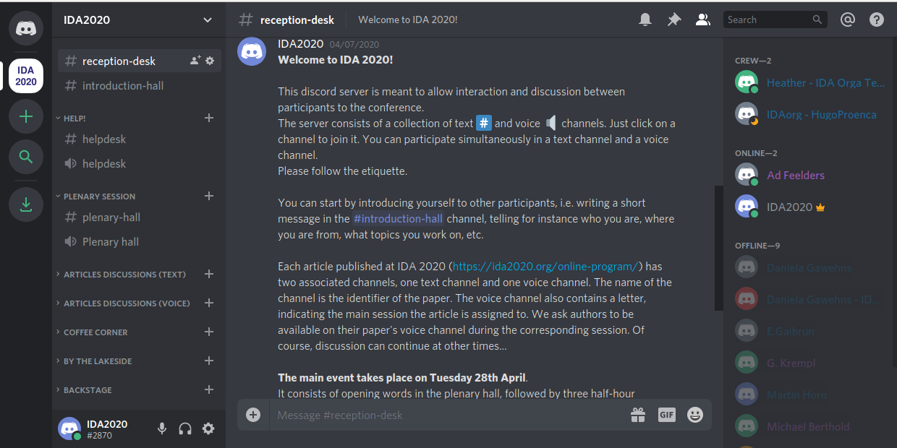
Discord looks like

Slide 10

Slack
Slack is basically a worse version of discord but works and slack is more professional so your best bet is slack.
Slack

Slide 11
How to use slack
Slack is basically once again just discord but more professional.
Once again you have friends you can direct message.
There are different channels multiple people can talk in.

Slide 12
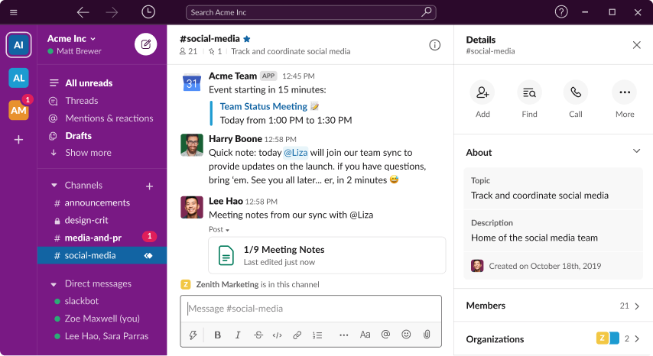
What does slack look like

Slide 13
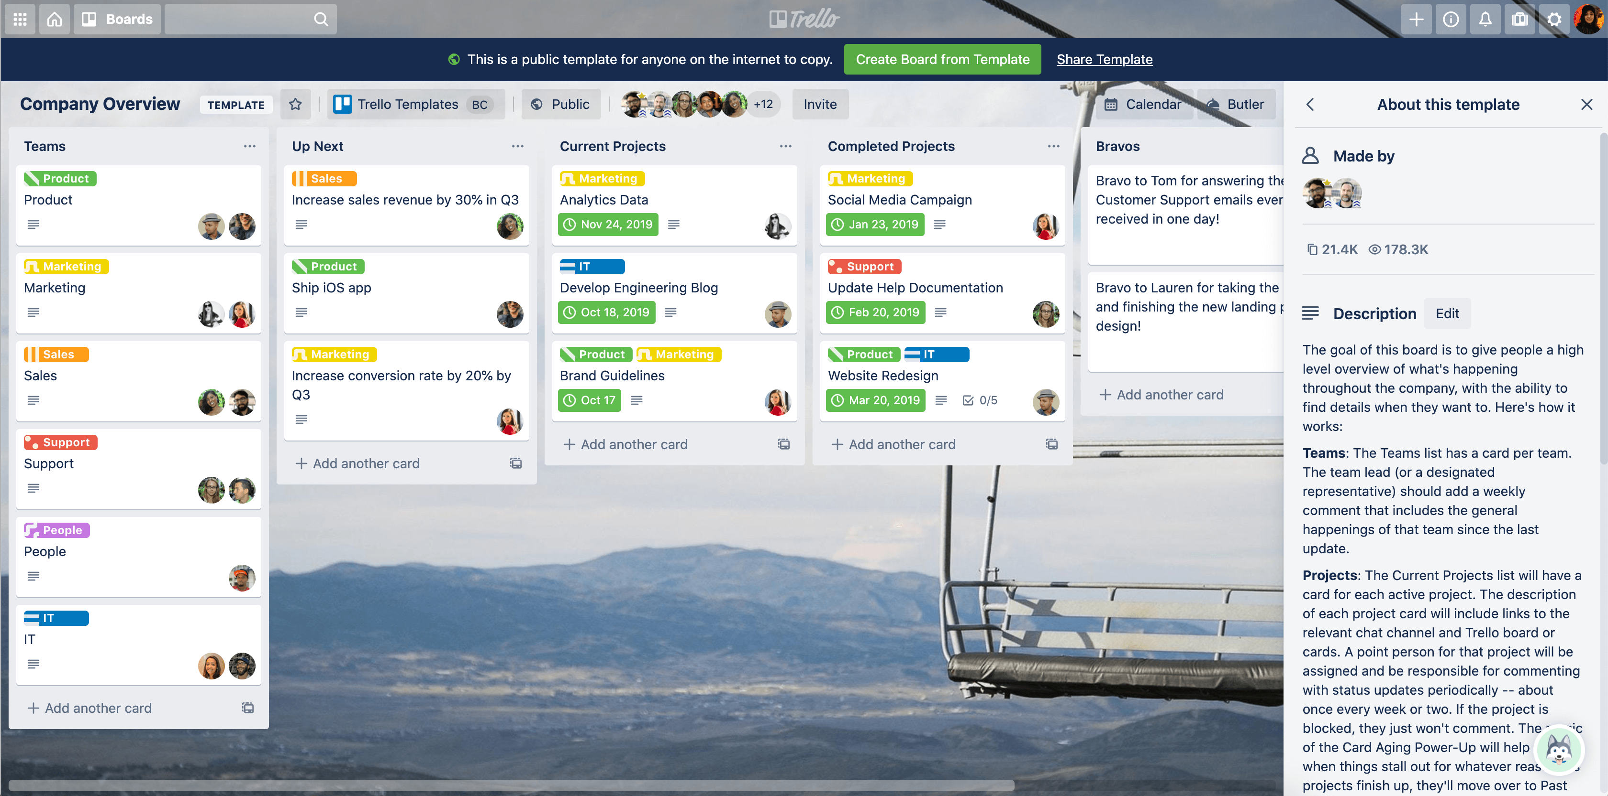
Trello board
Trello is another good way of communicating with your team its always a good way to split work and share who's working on what at them same time.
Trello literally says on there page “Trello helps teams move work forward”
Trello Board

Slide 14
How to use trello
You use trello by having one person create sort of like a team and invite everyone so only those people have access.
Once they do that you can create different tabs and assign each assignment to a different tab you can even mark who's doing what and when there done with that they move what they were assigned to the finish tab.

Slide 15
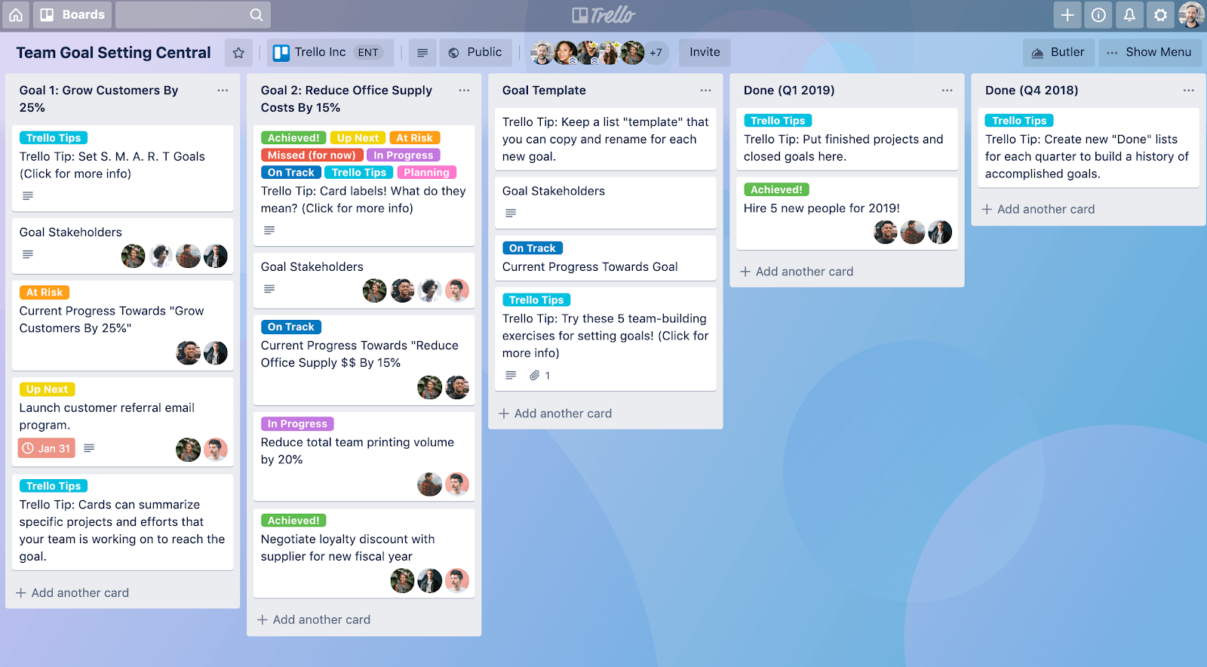
What trello looks like

